Slide 1
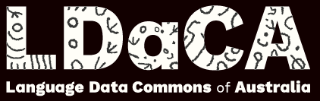
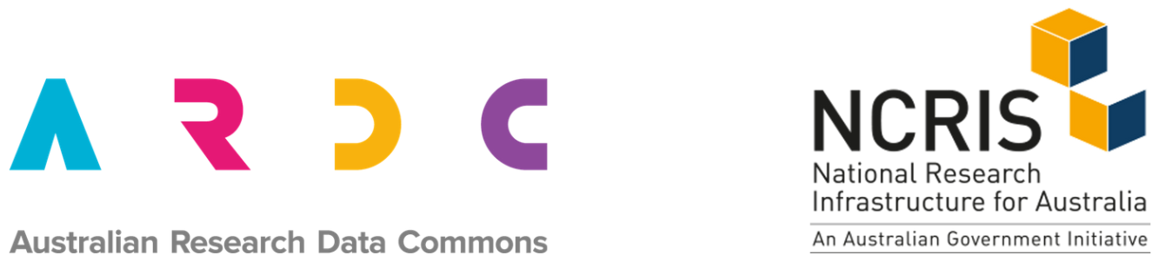
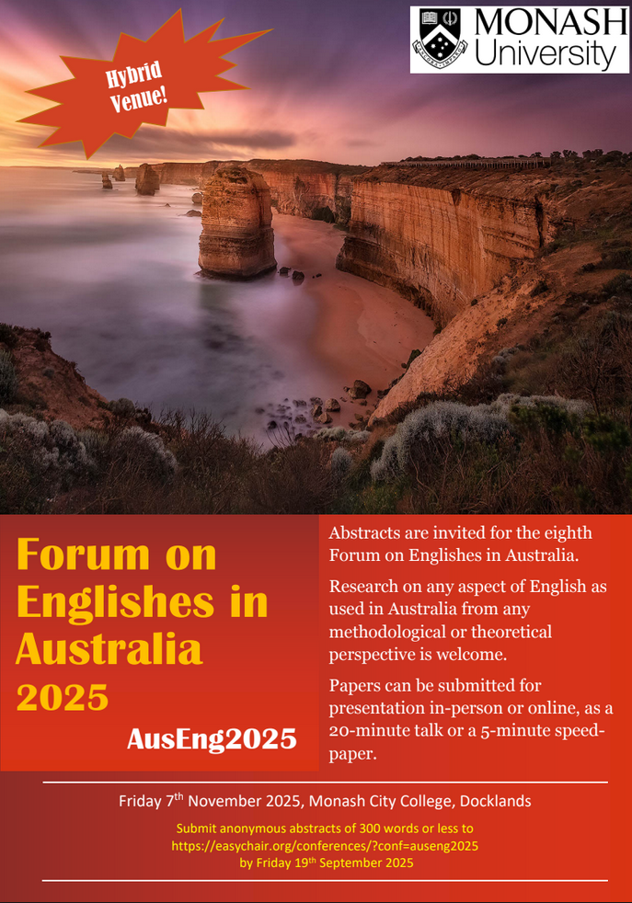
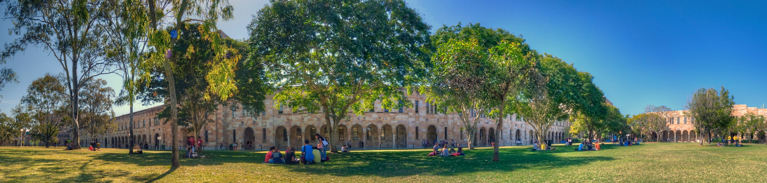
Standardizing Corpora: Why and How?
Martin Schweinberger m.schweinberger@uq.edu.au
This research was partially funded by the Language Data Commons of Australia (LDaCA). Language Data Commons of Australia (LDaCA) (DOI: 10.3565/kq2v-9g52) is a co-investment partnership with the Australian Research Data Commons (ARDC) through the HASS and Indigenous Research Data Commons. The ARDC is enabled by the Australian Government’s National Collaborative Research Infrastructure Strategy (NCRIS). In addition, this research was partially funded by the Centre for Digital Cultures and Societies at the University of Queensland.

Slide 2
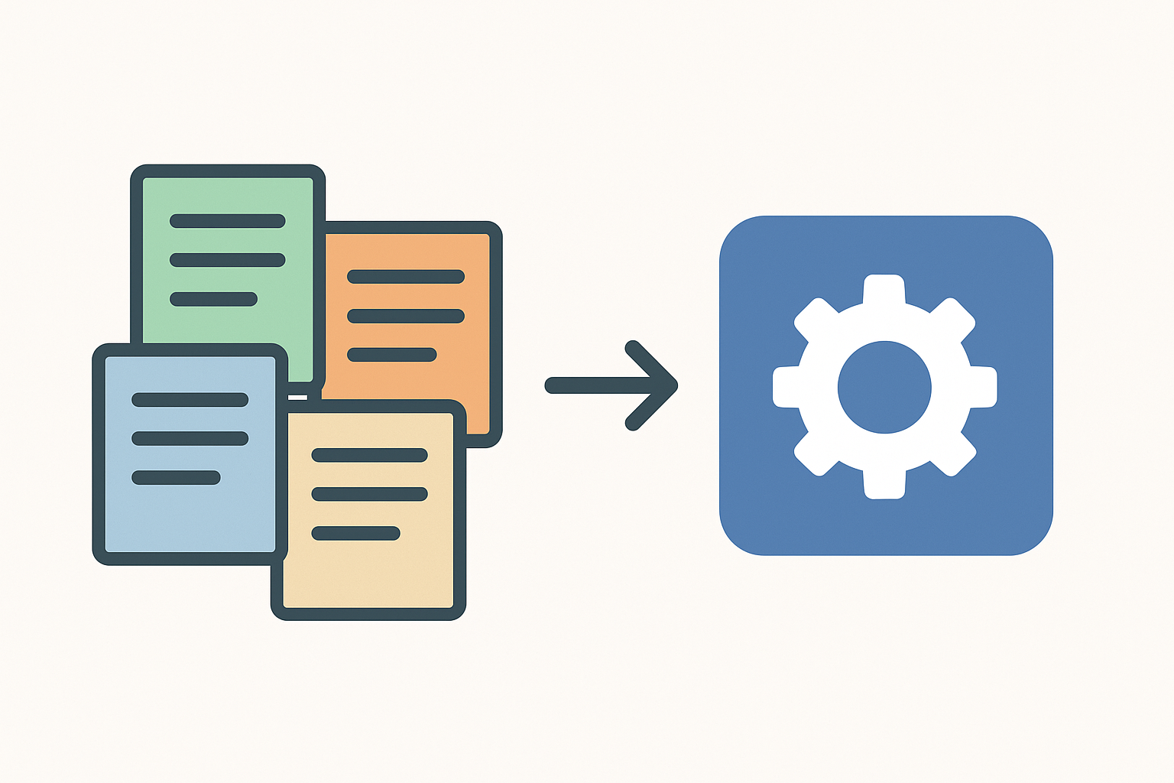
Why standard formats matter
Background
Corpora come in diverse, incompatible formats
Tools often require specific structures
Lack of standardization slows research and reuse (every corpus requires idiosyncratic pre-processing!)
CL community completely unaware of the issue!!!
A Tower of Babel: Format Diversity
Corpora in Different Formats
Texts: TXT, DOCX, PDF
Spreadsheets: CSV, Excel
Relational structures: XML, JSON, etc.
Multimpdal formats: ELAN, Praat TextGrids
Even more Diversity: Structure & Annotation
Corpora come in/with VERY Different Structures and Annotation
(the next slide will give you a taste…)
Schweinberger: Standardizing Corpora: Why and How?

Slide 3
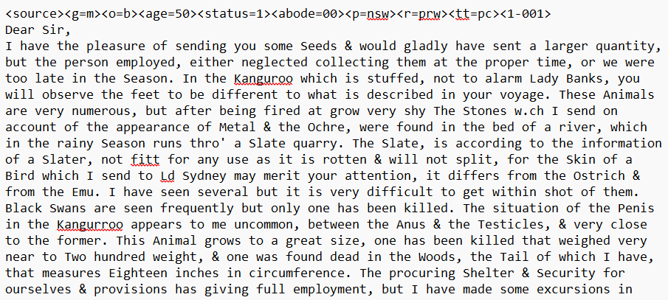
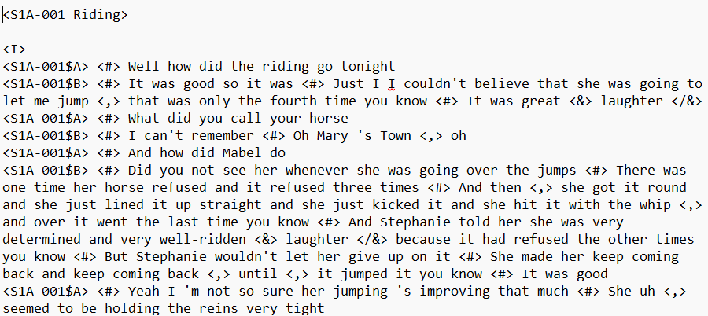
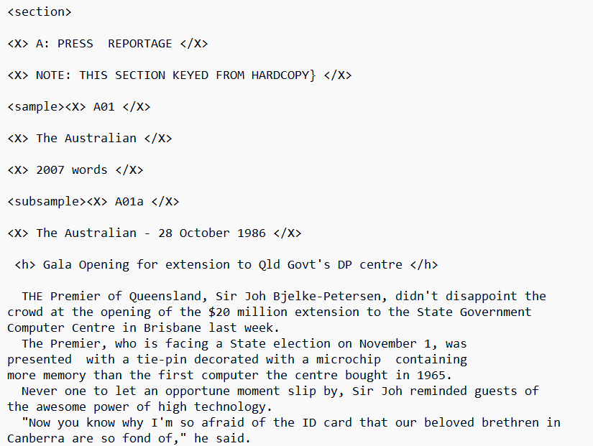
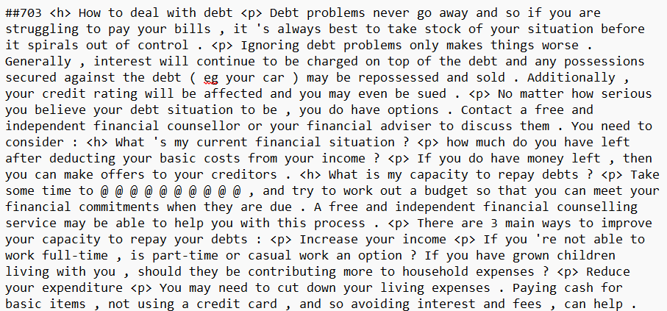
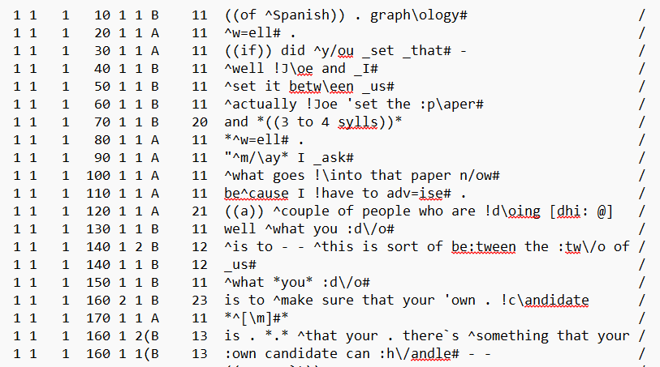
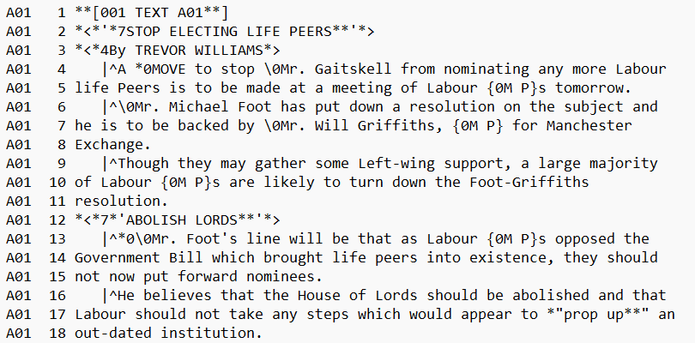
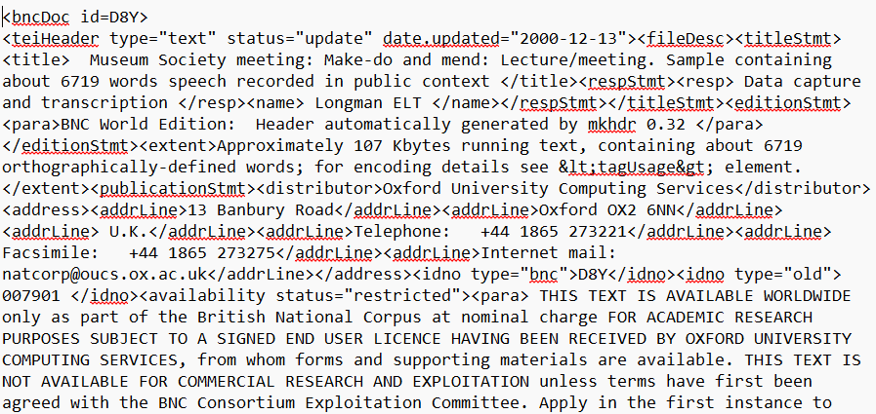
Diversity of Corpora (txt only!!!)
Schweinberger: Standardizing Corpora: Why and How?

Slide 4
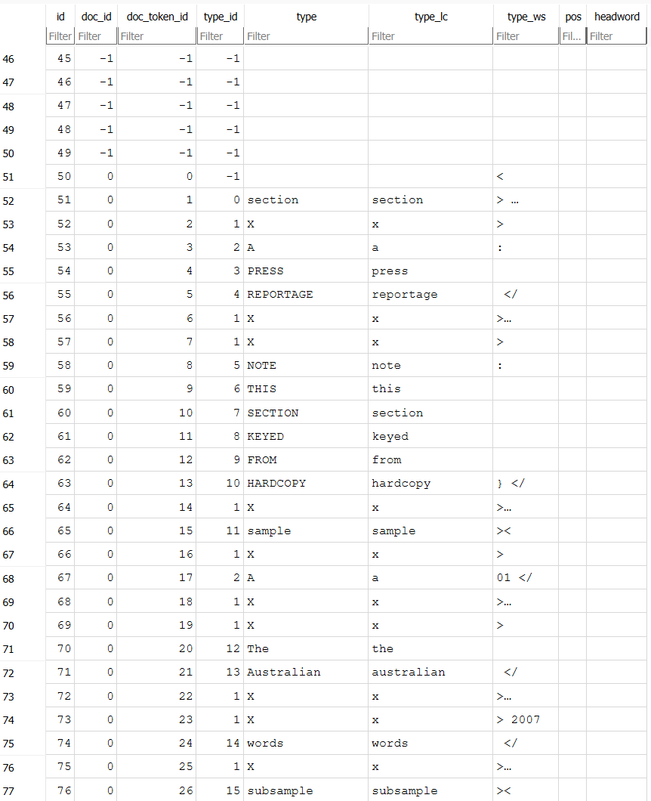
Two Ways to Deal With It
Option | Consequence
Tool adapts data format | Risk of information loss
Corpus aligns with a flexible standard | Tool can work with minimal restructuring
Multi-Table Separated Values (MTSV)
Used by AntConc / AntSoftware (most widely-used CL/TA software)
Benefits
Can be easily converted in ANY other format (txt, csv, etc.)
Storage-efficient and enables super fast retrieval (scalable)
Expandable (easy to add, e.g., speaker or pos-information)
Cross-disciplinary compatibility
Less dependence on commercial tools (free tools that have #LancsBox/SketchEngine functionality are easy to program!)
Takeaway
Standardized formats = faster, easier, reusable corpus research”

Slide 5
Standardizing Corpora: Why and How?
Martin Schweinberger m.schweinberger@uq.edu.au
This research was partially funded by the Language Data Commons of Australia (LDaCA). Language Data Commons of Australia (LDaCA) (DOI: 10.3565/kq2v-9g52) is a co-investment partnership with the Australian Research Data Commons (ARDC) through the HASS and Indigenous Research Data Commons. The ARDC is enabled by the Australian Government’s National Collaborative Research Infrastructure Strategy (NCRIS). In addition, this research was partially funded by the Centre for Digital Cultures and Societies at the University of Queensland.

